Slide 1
Operating Systems
SENS-3513
Week: 16
Segmentation
Operating System Concepts
9th edition
Silberschatz, Galvin & Gagne
John Wiley & Sons
2013
Dr Nauman Mazhar
Faculty of Information Technology (FIT)
University of Central Punjab (UCP)

Slide 2
Agenda
Basic concepts
Segmentation
Paged segmentation
2

Slide 3
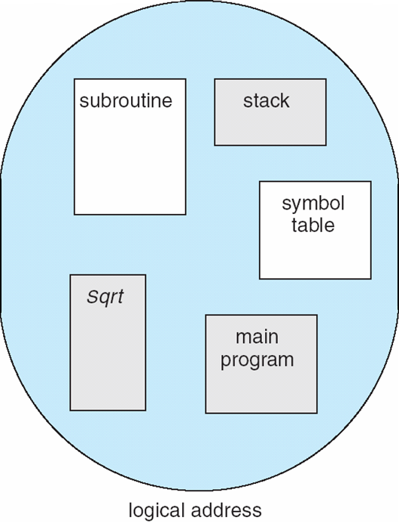
Segmentation
Memory-management scheme that supports programmer’s view of memory
Program is regarded as collection of segments
  segment is a logical unit of a program
  main(), procedures, functions, stack
  local variables, global variables
When program is loaded
  all its segments are loaded into partitions
  partitions are created dynamically
  each segment is loaded as one contiguous block
  all segments need NOT be contiguous
  segments can have different lengths
  but some max seg length
3

Slide 4
Logical View of Segmentation
1
1
4
2
3
4
2
3
Segment Table
User space
Physical memory space
Segments loaded into memory partitions, created dynamically
mapping is kept in Segmentation Table
4

Slide 5
Segmentation Example
Subroutine
Stack
Segment 3
Segment 0
1400
Symbol
Segment 0
Table
2400
Segment 4
SQRT
3200
Segment 1
Main
Program
Segment 3
Segment 2
Logical Address Space
Segment 2
4300
Segment Table
4700
limit base
Segment 4
0
1000 1400
5700
1
400 6300
Segment 1
6300
2
400 4300
6700
3
1100 3200
4
1000 4700
Segments loaded into memory partitions
5

Slide 6
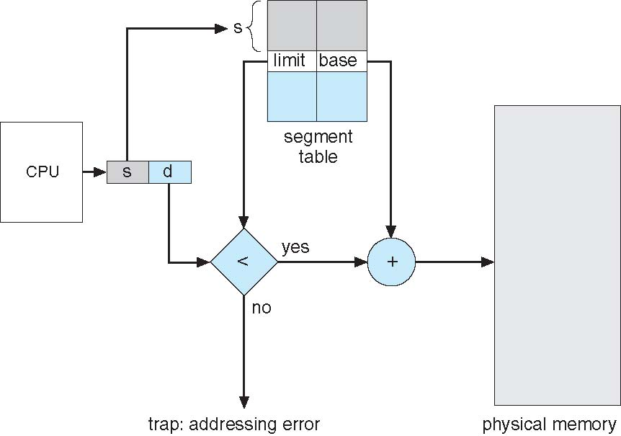
Segmentation Architecture
Logical address consists of: <segment-number, offset>
  segment number – index into segment table
  offset – displacement within the segment
Segment table :
each table entry has…
Base :
physical addr
where seg starts
in memory
added to offset to create
physical addr
Limit :
length of seg
checks for addressing error
6

Slide 7
Sample Problems
Problem
Consider the given segment table
What are the physical addresses for the following logical addresses:
    (2, 399) (4, 0) (4, 1000)
    (3, 1300) (6, 297)
Segment Table
limit base
0
1000 1400
1
400 6300
2
400 4300
3
1100 3200
4
1000 4700
Problem
Consider the given segment table
What are the physical addresses for the following logical addresses:
    (0, 430) (1, 10) (2, 500)
    (3, 400) (4, 112)
Seg Base Len
0 219 600
1 2300 14
2 90 100
3 1327 580
4 1952 96
7

Slide 8
External Fragmentation
Segmentation results in external fragmentation
  but free spaces can be adjusted by compaction
  shuffle segments to gather free memory spaces in one block
Compaction possible only if :
  relocation is dynamic – segment can be shifted dynamically to another location within the memory
  needs run time address binding
8

Slide 9
Paged Segmentation
To prevent External Fragmentation – page the segments
Paging:
  “every process had a Page Table”
  Page Table mapped pages to frames in physical memory
Paged Segmentation:
  every segment is further divided into pages
  “every segment of a process has a Page Table”
  Page table maps segment pages to frames in physical memory
  So, each process has one Segment Table, & multiple Page Tables
No External fragmentation
9

Slide 10
Paged Segmentation
Here we have divided segment 4 into four pages, and kept that info in page table
0
1
2
3
1
0
- - -
3
- - -
2
Stack
Subroutine
Segment 3
Segment 0
Symbol
3
1
126
10
Table
0
1
2
3
Segment 4
SQRT
Segment 1
Main
Program
10
Segment 2
Logical Address Space
Page Table
126
10

Slide 11
Paged Segmentation
Logical address (s, d) → s index into seg table
d offset within the segment
Seg offset d has two parts → p & d’
p index into page table (for segment s)
to retrieve frame number f
d’ offset within the page
Physical address is formed → (f, d’)
s
d
index segment table
p
d’
index page table
offset within the page p
11

Slide 12
Sample Problems
Problem
Consider a process in MULTICS with its segment #15 having 5096 bytes
Page size in segment is 1 KB
Process generates a Logical Address of (15, 3921), where 15 is segment number and 3921 is offset
  Is it a legal address; if yes why
  How many pages does the segment have
  What page does the logical address refer to, and what is its offset
  What is the Physical Address, if page#3 (fourth page) is in frame 12
12

Slide 13
Sample Problems
Problem
In paged segmentation, consider a logical address of (16, 7865), where 16 is segment number and 7865 is offset
Suppose segment 16 has length of 15690 bytes & page size is 2 KB
Calculate following:
  Number of pages in segment number 16
  In which page the above said offset will reside
  How would you represent the above address in <s, p, d’> format
  Let the page p be stored in frame 30; what would be the physical address
13

